Slide 1
FE Review – Basic Circuits
William Hageman
Kansas State University
11-18-2014
Available at: https://www.engg.ksu.edu/docs/fe-exam/FE%20Exam%20Review%20-%20Circuits%20-%2011182014.pdf
Edited by
Russ Tatro
California State University Sacramento
04-11-2017

Slide 2
FE topics
General FE
14. Electricity, Power, and Magnetism 7–11
Electrical fundamentals (e.g., charge, current, voltage, resistance, power, energy)
Current and voltage laws (Kirchhoff, Ohm)
DC circuits
Equivalent circuits (series, parallel, Norton’s theorem, Thevenin’s theorem)
Capacitance and inductance
AC circuits (e.g., real and imaginary components, complex numbers, power factor, reactance and impedance)
Measuring devices (e.g., voltmeter, ammeter, wattmeter)
Mechanical FE
Electricity and Magnetism 3–5
Charge, current, voltage, power, and energy
Current and voltage laws (Kirchhoff, Ohm)
Equivalent circuits (series, parallel)
AC circuits
Motors and generators
Industrial FE
Engineering Sciences 5–8
Work, energy, and power
Material properties and selection
Charge, energy, current, voltage, and power
Chemical FE
Engineering Sciences 4–6
Applications of vector analysis (e.g., statics)
Basic dynamics (e.g., friction, force, mass, acceleration, momentum)
Work, energy, and power (as applied to particles or rigid bodies)
Electricity and current and voltage laws (e.g., charge, energy, current, voltage, power, Kirchhoff, Ohm)

Slide 3
Topics to Be Covered
DC Circuits and Analysis
Thevenin/Norton Equivalent Circuits
Maximum Power Transfer
RC and LC Transients
DC Voltage
DC Current
Power
Resistance
Resistivity
Ohms Law
Series and Parallel Combinations of Resistors
Voltage and Current Dividers
Capacitors
Inductors
Kirchhoff’s Laws
Simple Resistive Circuit Solving
Delta-Wye Transforms
Superposition
Source Transforms and
AC Circuits
AC Waveforms
Sine and Cosine Relations
RMS Values
Phasor Transforms
Phase Angles
Impedance
Ohm’s Law for AC circuits
Complex Power
Resonance
Transformers

Slide 4
DC Circuits and Analysis

Slide 5
Definition of Voltage
Separating electric charge requires energy. The potential energy per unit charge created by charge separation is VOLTAGE. It is often referred to as electrical potential.
dw
where v = voltage in volts,
dq
w = energy in joules
q = charge in coulombs
It is a Δ quantity… i.e. measured at one point relative to another… most typically relative to the electrical potential of the Earth (ground).

Slide 6
Definition of Current
Flowing charges create electrical effects. The rate of charge flow is called CURRENT
dq
where i = current in amperes,
dt
q = charge in coulombs t = time in seconds
We typically think of current flowing through wires in our circuits much like water through pipes

Slide 7
Electrical Power
The power supplied or dissipated in a circuit element can be found from the following relation:
P = iv
A negative power denotes power being supplied by the element, positive power denotes power being dissipated by the element

Slide 8
Resistance
Resistance is the ability of a circuit element to impede current flow. It is denoted by R.
R
Resistance is measured in Ohms (Ω). Energy is dissipated in a resistor and converted into heat.

Slide 9
Resistivity
Resistivity (ρ) is a material property that governs resistance. The resistivity of a material along with its physical geometry determine its resistance. It is defined in terms of units of (Ohm * meters)
l
R = ρ ^{l}
A
A

Slide 10
Ohm’s Law
Ohm’s Law provides a relationship between the voltage dropped across a resistive element and the current flowing through it.
By convention, the ohm’s law voltage drops in the direction of current flow
v = iR

Slide 11
Power dissipated in a Resistor
Recall that: Power = v*i
Using Ohm’s Law, the power dissipated in a resistor can be re-written multiple ways:
P = (i*R)*i = i²R P = v*(v/R) = v²/R
These expressions hold true regardless of sign convention… Power is always dissipated in a resistor.

Slide 12
Combinations of Resistors
Separate Resistors in a circuit can be combined to create a simplified equivalent resistance
Resistors in Series
When resistors are connected in series (end to end) they can simply be added
^{R}eq
= R₁ + R₂ + R₃ + R₄ +...

Slide 13
Combinations of Resistors
Resistors in Parallel
When resistors are connected in Parallel (side to side) they add in the inverse

Slide 14
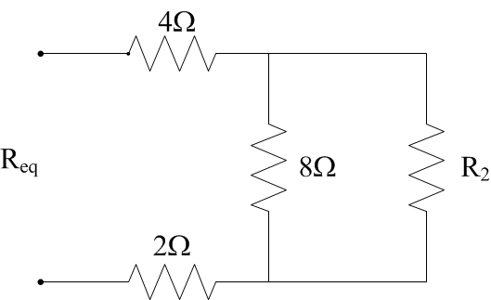
Example FE Problem
If R_{eq} = 10.8 Ω, what is R₂?
12Ω
20Ω
8Ω
18Ω

Slide 15
Solving DC Circuits
We have covered voltage and current (the two parameters we wish to find throughout an electrical circuit) as well as basic circuit elements.
This allows us to begin to construct and model basic resistive circuits
We will need some basic circuit theorems in order to solve these circuits.

Slide 16
Circuit Terminology

Slide 17
Practice
How Many Nodes? How Many Branches?
How Many Essential Nodes? How Many Essential Branches?
How Many Meshes?

Slide 18
Kirchoff’s Current Law
Kirchoff’s Current Law (KCL)
The algebraic sum of all the currents at any node in a circuit equals zero
This means that the net current entering a node is equal to the net current exiting the node… no charge is stored in the node.
To use KCL you must assign a sign to use for all current entering the node, and an opposite sign to all current exiting the node. All currents entering and exiting the node are then summed to zero.

Slide 19
Kirchoff’s Voltage Law
Kirchoff’s Voltage Law (KVL)
The algebraic sum of all the voltage drops around any closed path in a circuit is equal to zero
A closed path in a circuit is a path that takes you from a starting node back to that node without passing through any intermediate node more than once
To use KVL, simply find a closed path and sum the voltage drops you encounter and set the sum equal to zero

Slide 20
Systematic Approach
By immediately identifying the essential nodes and branches of a circuit, we can immediately go about systematically solving the circuit.
Using KVL and KCL on essential nodes and branches is a perfectly good and valid technique for circuit solving
However, there are new variables called node voltages and mesh currents that let us further reduce the number of equations needed for solving a circuit

Slide 21
Node-Voltage Method
1st Steps in Node-Voltage Method
Make a neat layout of your circuit with no branches crossing over
Mark the essential nodes
Pick one of the essential nodes to be your reference node and mark it. (typically the node with the most branches)
Define the node voltages (voltages from reference node to other essential nodes)

Slide 22
Node-Voltage Method Continued
With the node voltages labeled in your circuit you are ready to generate your node-voltage equations
– This is done by writing each of the essential branch currents leaving the essential nodes in terms of the node voltages and then summing them to zero in accordance with Kirchoff’s current law.

Slide 23
Example of N-V method
(1)
(3)
(2)
There are three branch currents coming out of node 1:
The current (1) through the 1Ω resistor and 10V source The current (2) through the 5Ω resistor
The current (3) through the 2Ω resistor
These can be written in terms of the node voltages, v₁ and v₂.
v ₁ − 10 V
v ₁ ₊ v ₁ − v ₂
+
= 0
1 Ω
5 Ω
2 Ω

Slide 24
Finishing Example
This same process can be used to produce the N-V equation for node 2.
v₂ − v₁ ₊ v₂
2 10
− 2 = 0
These two equations have two unknowns, v₁ and v₂, thus the two node voltages can be calculated and the branch currents
determined from them.
v₁ = 9.09V v₂ = 10.91V

Slide 25
Exercise
Find the two node voltage equations that would allow us to find v₁ and v₂.

Slide 26
Solution
v ⎜ + ¹ ⎟ − v ⎜ ¹ ⎟ = 1mA
⎛ 1
⎞ ⎛ ⎞
1 2
⎝12k 6k ⎠ ⎝ 6k ⎠
v ⎜− ¹ ⎟ + v ⎜ ¹ + ¹ ⎟ = −4mA
⎛
⎞ ⎛
⎞
1
⎝
6k ⎠ ² ⎝ 6k 6k ⎠
3v₁ − 2v₂ = 12V
− v₁ + 2v₂ = −24V
v₁ = 2v₂ + 24 3(2v₂ + 24)− 2v₂ = 12V
v₁ ₊ v₁ − v₂
12k 6k
Node with v1:
−1mA +
= 0
4v₂ = −60V
v₂ = −15V
Node with v2:
3v + 30 = 12V
1
v₁ = −6V

Slide 27
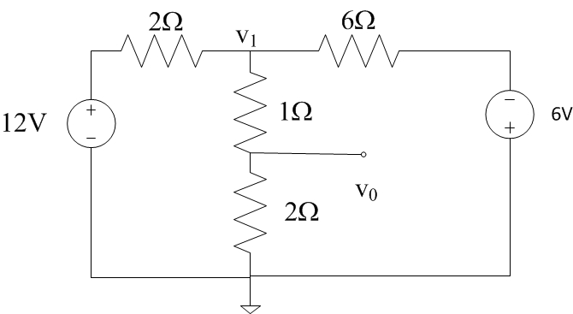
Example FE Exam Problem
Find Vo in the circuit.
a) 3.33 V
b) 8.25 V
c) 9.33 V
d) 2.25 V

Slide 28
Additional Techniques

Slide 29
Voltage Divider
The voltage divider is a simple way to find the voltage across two resistors in series.
⎛
R
⎞
v = v ⎜⎜
1
⎟⎟
1 s
R + R
⎝ 1 2 ⎠
⎛
R
⎞
v = v ⎜⎜
2
⎟⎟
2 s
R + R
⎝ 1 2 ⎠

Slide 30
Current Divider
The current divider allow you to find the current flowing through one of two parallel resistors
⎛ R ⎞
⎛
R
⎞
i = i ⎜⎜
2
⎟⎟
i = i ⎜⎜
1
⎟⎟
1 s
R + R
2 s
R + R
⎝ 1 2 ⎠
⎝ 1 2 ⎠

Slide 31
Delta-Wye Transforms
There is another simplification that can be made to make solving resistive circuits easier
This is the Delta-Wye Transform

Slide 32
Transform Equations
Delta to Y
R_{b} R _{c}
Y to Delta
+ R ₂ R ₃ + R ₃ R₁
R₁
+ R ₂ R ₃ + R ₃ R₁
R ₂
+ R ₂ R ₃ + R ₃ R₁
R₁ R ₂
R =
R =
1
R _{a} + R_{b} + R _{c}
R _{c} R _{a}
a
R₁ R ₂
R =
R =
2
R _{a} + R_{b} + R _{c}
R _{a} R_{b}
b
R₁ R ₂
R =
R =
3
R _{a} + R_{b} + R _{c}
c
R ₃

Slide 33
Superposition
All linear systems obey the principle of superposition.
This means that whenever a linear system is driven by multiple sources, the total response of the system is the sum of the responses to each individual source
This principle is used in all areas of engineering and physics and is of course useful in Circuit Theory

Slide 34
What does this mean for solving
circuits?
The value of voltage or current relating to any element in a circuit can be thought of as the sum of the voltages and currents resulting on that element from each of the independent sources in the circuit individually.
v₁
v₂
=
v₂’’
v₁’
v₂’
v₁’’
+
i₃ = i₃ '+i₃ ''
i₄ = i₄ '+i₄ ' '
i₁ = i₁ '+i₁ ''
i₂ = i₂ '+i₂ ' '
v₁ = v₁ '+v₁ ''
v₂ = v₂ '+v₂ ' '

Slide 35
Uses for superposition
Superposition is highly useful if you have a circuit that you have already solved that is altered by adding a new source of some type.
All you need to do is deactivate all the original sources and find the values resulting from your new source
The true altered values in your circuit are just the original values plus what results from the new source
Also very useful when analyzing multiple signals in a system. You find found the output for each signal individually and then sum the results to find that full solution.

Slide 36
Example
'
⎛ 25 ⎞
⎛ 25 ⎞
With only 24V source:
v = 24V ⎜
⎟ = 24V ⎜
⎟ = 4.8V
o
⎝ 20 + 80 + 25 ⎠
⎝ 125 ⎠
v = −40mA(25 //100) = −40mA⎜
⎛ 25(100) ⎞
With only 40mA source:
''
⎟ = −0.8V
o
⎝ 25 +100 ⎠
'
''
v = v +v = 4.8−0.8= 4V
o
o
o

Slide 37
Source Transformations
Another method like Delta-Wye and Parallel/Series combinations to simplify circuits
Can switch between equivalent sources: a voltage source with series resistor or current source with parallel resistor

Slide 38
How to Transform
Each of the two equivalent sources must produce the same current through any load connected across the source.
R_{L}
R_{L}
I =
v_{s}
R
load
R + R_{L}
I = i
(current divider)
load
s
R + R
L
v_{s}
= i
R
v = i R
v
s
OR
OR
i
=
s
R + R_{L}
R + R_{L}
s
s
s
R

Slide 39
Source Transform Example
What is Power of 6V source?
i
i = (19.2V-6V)/16 = 0.825A
P = i*v = 0.825A*6V = 4.95W

Slide 40
Example FE Exam Problem
Find I in the circuit.
8 A
-4 A
0 A
4 A

Slide 41
Thevenin Equivalent Circuits

Slide 42
Terminal Behavior
We are often interested in looking at the behavior of an electrical circuit at it’s output terminals.
If a load is hooked to a circuit, how does the circuit behave relative to the load?
If the circuit is made of linear elements, the entire circuit can be simplified into a Thevenin (or Norton) Equivalent circuit.

Slide 43
Justification
We can consider the entire circuit a black box with two output terminals. The behavior at these terminals can be modeled by a voltage source and a series resistor.

Slide 44
Finding the Thevenin Voltage
If we look at the terminal with no load attached (open circuit output), the voltage between the output terminals is V_{Th}.
With an open circuit, no current flows This means no voltage drop across R_{Th} Hence V_{ab} = V_{Th}

Slide 45
Finding Thevinen Resistance
Now lets look at what happens when the output is short circuited
₌ ^{V}Th
i
sc
^{R}Th
^{i}sc
₌ ^{V}Th
R
Th
^{i}sc
If we can find the short circuit current and have already found V_{Th}, then we can easily calculate R_{Th}

Slide 46
Power Transfer
We are often concerned with maximizing the amount of power we transfer from one circuit to another
In Power systems the primary concern is efficiently transferring power to the load. Losses must be kept to a minimum.
In communication systems we often want to transfer data from a transmitter to a detector. Optimizing the power that is transferred to a receiver or other load circuit is highly important

Slide 47
Maximum Power Transfer
We have some network of sources and linear elements and will connect this network to a load R_{L}. We want to maximize power in the load.
The power transfer is maximized when R_{L} is equal to R_{TH}

Slide 48
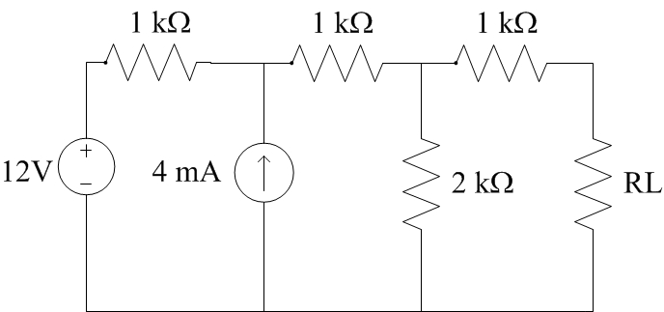
Example FE Problem
Determine the maximum power that can be delivered to the load resistor R_{L} in the circuit shown.
2 mW
10 mW
4 mW
8 mW

Slide 49
RL and RC Circuits

Slide 50
Inductors
Inductors are magnetic coils the produce an induced voltage proportional to the rate of change of current in the coil
v(t) = L ^{di}
Current and Voltage Relations
dt
1
t
i(t) = ∫ vdτ + i(t₀ )
L
t₀
P(t) = Li ^{di}
Power as a function of time
dt
Energy Stored in the inductor

Slide 51
The Capacitor
A capacitor is a circuit component represented by the letter C
Capacitance is measured in Farads
Typical values are in the pF to μF range
A 1F capacitor is extremely large
The symbol for a capacitor is shown below:
Sign Convention

Slide 52
Capacitor Current and Voltage Relations
The current and voltage relations for a capacitor are opposite to those of the inductor
Inductor: Capacitor:
v(t) = L ^{di}
i(t) = C ^{dv}
dt
dt
1
t
1
t
i(t) = ∫ vdτ + i(t₀ )
L
v(t) = ∫idτ + v(t₀ )
C
t₀
t₀

Slide 53
Power and Energy Relations
Similarly, the power and energy storage relationships for a capacitor are reversed in terms of voltage and current from those of the inductor:
Inductor Capacitor
Power as a function of time
P(t) = Li ^{di} P(t) = Cv ^{dv}
dt dt
Stored Energy

Slide 54
Series and Parallel Combinations of
Inductors and Capacitors
Inductors add in series much like resistors:
v = L ^{di}
di
_{= L} di
v = L
v
¹ dt ² dt
1
2
3
³ dt
v = v + v + v = (L + L + L ) ^{di} = L
di
1 2 3 1 2 3
dt
eq _{dt}
^{L}eq
= L₁ + L₂ + L₃ + L₄ +... + L_{n}

Slide 55
Parallel Inductors
i = i₁ + i₂ + i₃
1
t
1
t
1
t
i₁ = ∫ vdτ + i₁ (t₀ )
L
i₂ = ∫ vdτ + i₂ (t₀ )
L
i₃ = ∫ vdτ + i₃ (t₀ )
L
1 t₀
2 t₀
3 t₀
⎛ 1
1 1 1
1 ⎞
−1
i(t₀ ) = i₁ (t₀ ) + i₂ (t₀ ) +... + i_{n} (t₀ )
^{L}eq
= ⎜⎜ _{L} + _{L} + _{L} + _{L} +...
+ ⎟
_{L} ⎟
⎝ 1
2
3
4
n ⎠

Slide 56
Combinations of Capacitors
Capacitors add when in parallel:
i₁
i₂
i₃
i = i₁ + i₂ + i₃
i = C ^{dv} i = C
dv
² dt
i = C
dv
³ dt
1
¹ dt
2
3
i = i + i + i = (C + C + C ) ^{dv} = C
dv
1 2 3 1 2 3
eq
dt dt
^{C}eq
= C₁ + C₂ +... + C_{n}

Slide 57
Series Combinations of Capacitors
Inductors add in the inverse when in parallel, just like resistors
v = v₁ + v₂ + ... + v_{n}
1
t
v₁ = ∫idτ + v₁ (t₀ )
C
1 t₀
1
t
+ v₁ (t₀ )+ v₂ (t₀ )+... + v_{n} (t₀ )
v₂ =
∫idτ + v₂ (t₀ )
C
2 t₀
1 ^{t}
v_{n} = ∫idτ + v_{n} (t₀ )
C
C
n
v_{n}
n t
0
v(t₀ ) = v₁ (t₀ ) + v₂ (t₀ ) +... + v_{n} (t₀ )

Slide 58
RC and RL Circuit Transients
Inductors and capacitors can be charged or discharged through a resistive element
Discharge
Charge

Slide 59
General Form of RC and RL Response
All off these simple RC and RL circuits have the same form of response:
•X can be current or voltage in either the inductor or capacitor
•Tau is the time constant:
•τ=RC for RC circuit
•τ=L/R for RL circuit

Slide 60
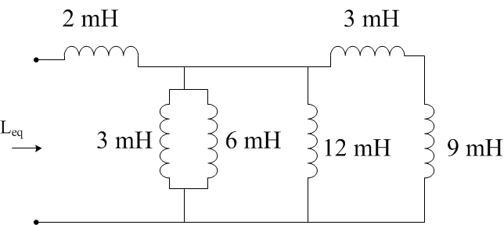
Example FE problem
What is the equivalent inductance of the circuit?
9.5 mH
2.5 mH
6.5 mH
3.5 mH

Slide 61
Example Problem #2
What is the voltage across the 10 mH inductor expressed as a function of time?
a)
b)
c)
d)

Slide 62
AC Circuits and Analysis

Slide 63
AC Waveforms
AC waveforms are sinusoidal and can be described by either a sine or cosine
v(t) = V_{m} cos(ωt + φ )
V_{m} = Amplitude
ω = angular frequency (equal to 2πf or 2π/T) φ = phase constant

Slide 64
Sine-Cosine Relations
The following are useful relationships for AC circuits:
cos(ωt) = sin(ωt + ^{π} ) = −sin(ωt − ^{π} )
2 2
sin(ωt) = cos(ωt − ^{π} ) = −cos(ωt + ^{π} )
2 2

Slide 65
RMS Values
AC sinusoids have an average of zero, so we use RMS (root of the mean squared function) to get a measure for effective average value.
1
T
t₀ +T
(V cos(
ωt + φ )) dt
^{V}rms
=
∫
t₀
2
m
₌ V_{m}
V
rms
2

Slide 66
Phasors and Phasor Transform
We use Euler’s Identity to express sinusoidal functions in the complex –number domain.
_{e}± jθ
= cosθ ± j sinθ
Euler’s Identity
ωt + φ) = V_{m}ℜ{e
j (ωt +φ ) }
= V_{m}ℜ{e
jωt jφ }
v = V cos(
e
m
The Phasor Representation or Phasor Transform of a Sinusoidal waveform:
V = V e ^{jφ} = P{V
m m
cos(ωt + φ)}

Slide 67
Impedance
Impedance (Z) is the complex analog to simple resistance.
V = ZI
Ohm’s Law for AC Circuits
Circuit Element | Impedance | Reactance
Resistor | R | -
Inductor | jωL | ωL
Capacitor | -j/ωC | -1/ωC
Reactance is the imaginary part of the Impedance

Slide 68
Kirchhoff’s Laws with AC circuits
All of Kirchhoff’s Laws still hold with the phasor transform
– Just sum complex currents and voltages in either the polar or rectangular form
Impedances simply sum when in series and sum in the inverse when in parallel (just like resistors)

Slide 69
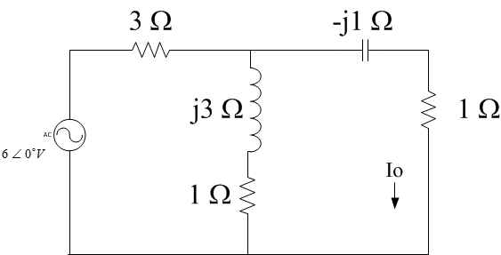
FE exam problem
What is the current Io in the circuit?
a)
b)
c)
d)

Slide 70
Two coils are wound on a single core to ensure magnetic coupling
Transformers

Slide 71
Ideal Transformer
For an ideal transformer the voltages and currents through each winding are related as shown below:
V₁ ₌ V₂
I₁ N₁ = I₂ N₂
N₁ N₂
N₁=number of winding in coil 1
N₂=number of winding in coil 2
V₁= voltage across coil 1
V₂= voltage across coil 2
I₁ = Current through coil 1
I₂ = Current through coil 2

Slide 72
Voltage Polarity in an Ideal Transformer
The four circuits below show the dot convention and the relative voltage polarity and direction of current
Voltage that is positive at a dotted terminal results in a voltage that is positive at the other dotted terminal
Current flowing into a dotted terminal should result in current flowing out of the other dotted terminal

Slide 73
AC POWER
Instantaneous Power = v(t)*i(t)
• =P+Pcos(2ωt)+Qsin(2ωt)
V_{m} I_{m}
P=Average Power=
cos(
φ − φ )
2
v i
Q=Reactive Power= ^{Vm Im} sin(φ − φ )
2
v i

Slide 74
Complex Power
We have discussed Real Power (P) and Reactive Power (Q)
These can be thought of as the real and imaginary components of complex power (S)
S = P + jQ

Slide 75
Apparent Power
When plotted in the complex plane, Complex Power can be though of as the result of the addition of perpendicular P and Q.
θ = (φ_{v} − φ_{i} )
The magnitude of the complex power |S| is known as Apparent Power

Slide 76
Meaning of Apparent Power
Apparent Power is the amount of Power that must be generated in order to supply a given amount of average power
If the circuit has reactive elements (which any power network will, such as power lines, generator windings, etc.) There will be a reactive element to the total power.
If |Q|>0, then the amount of power that must be supplied to drive a circuit that is dissipating a certain amount of real power (P) is greater than P.
Q can be balanced by compensating inductance with capacitance, making the power factor [cos(φ_{v}-φ_{i})]=1
With proper balancing the amount of apparent power needed to provide a given average power to a load can be minimized

Slide 77
Expressions for Power
Real Power:
P = I_{rms}V_{rms} cos(φ_{v} − φ_{i} )
^{V}rms
2
R
2
P = I R =
rms
R² + X ²
Reactive Power: Q = I_{rms}V_{rms} sin(φ_{v} −φ_{i} )
^{V}rms
2
X
2
Q = I Χ =
rms
R² + Χ²
Complex Power:
S = I
*
V
rms rms
^{V}rms
2
2
S = I Z =
rms
_{Z} *

Slide 78
Maximizing Power Delivered to a Load
Remember from resistive circuits that the maximum power delivered from a circuit to a load resistor occurred when the load resistance was equal to the Thevenin Resistance of the driving circuit.

Slide 79
Maximizing Power Transfer with complex circuits
With circuits containing reactive elements, maximum power is transferred when the load impedance is equal to the complex conjugate of the Thevenin Equivalent Impedance
*
Th
V
2
Z_{L} = Z
₌ 1 Th
P
max
4 R_{L}

Slide 80
Explanation
Look at a complex impedance in series with it’s complex conjugate:
^{Z}Th
= A + jB
*
Z = A − jB
Th
*
Z + Z = A + jB + A − jB = 2 A
Th
Th
The reactive elements will cancel, causing the total power factor to equal 1. Each element has the same resistance resulting in maximum power transfer into the resistive part of the load (max real power)

